Slide 1
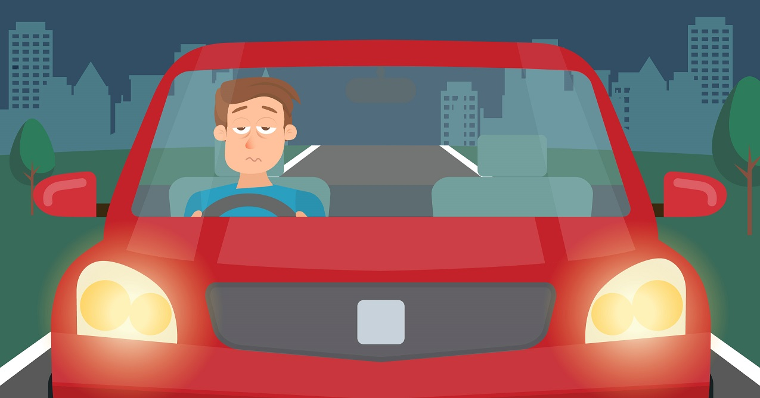
Driver
Drowsiness
Detection

Slide 2

The Problem
We are familiar with the hazards of drinking and driving or even texting and driving, but many people underestimate the dangers of drowsy driving. Drowsy driving, also known as driver fatigue or tired driving, is the act of driving or operating a motor vehicle while tired and feeling fatigued or sleepy.
Each year, drowsy driving accounts for about 100,000 crashes, 71,000 injuries, and 1,550 fatalities, according to the National Safety Council (NSC).
According to AAA, drowsy driving contributes to an estimated 9.5% of all crashes.
About 43% of the total road accidents occur on national highways, according to the Accident Research Institute (ARI) of Bangladesh University of Engineering and Technology (BUET). One of the reasons behind this is driving carelessly and faulty driving.
Thus, a system that could detect drowsiness of a driver and alert the drivers to stay awake in the scenario of driving while drowsing, or let them know to stop driving, and take some rest or even freshen up to continue driving. Such system availability could decrease the chances of causing an accident, if not a fatal one.

Slide 3
Dataset
The dataset used in this project is available and taken from Kaggle.
The name of the dataset is yawn_eye_dataset_new.
The dataset consists of 4 different classes of images ( Closed eyes, Open Eyes, Yawning face, Non-Yawning face).
Closed and Open eyes image were zoomed in images of only the eyes while the yawning and non-yawning had a background and the whole face of the driver.
The dataset consisted of 2900 images, with each of the classes having somewhat over 700 images.
The size of the dataset is about 170MB.

Slide 4
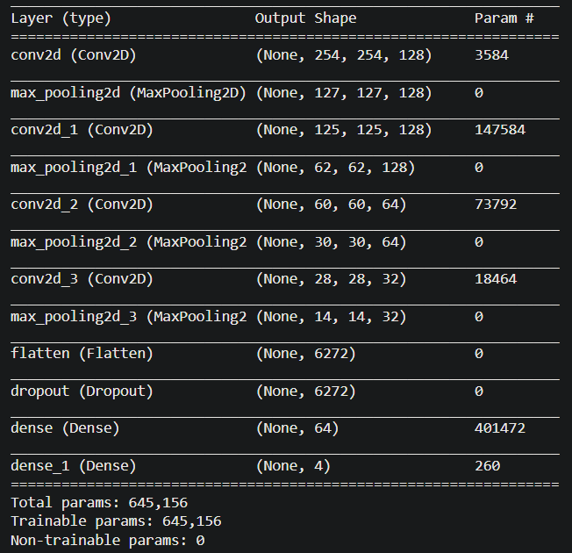
Results
We used an image size of 256, thus we had to use a lower number of batch size, a number of 16 because of insufficient technical resources.
We used two models,
i) CNN based ii) ResNet50
For the CNN model (summary shown on the figure on right side), total 7 epochs were performed for this model, and an accuracy of 91.98% for training and 93.77% for test was measured by the best model (on 6th epoch).

Slide 5
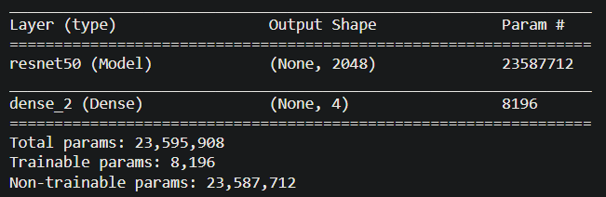
Results
For the ResNet50 model (summary shown in the figure on downward), total 10 epochs were performed for this model and an accuracy of 95.47% for training and 93.77% for validation accuracy (same as the CNN) which was measured in the 3rd epoch, where from the 4th epoch the model start overfitting the data (training loss << validation loss)

